Slide 1

Planning a survival analysis study … and data management issues
Steve Simon for
Notes:
Analyzing Repeated Measures Data Workshop: Module 5 The Linear Mixed Model
Copyright 2011 The Analysis Factor http://TheAnalysisFactor.com
1

Slide 2
Abstract
Lecture 3. Planning and data management issues for survival data. Planning a study with a survival outcome requires you to specify both the number of patients and the duration of follow-up time. You’ll compute power for hypothetical studies and compare power across different research designs. Then you’ll review the data management needs of a survival study, with a special emphasis on the problems associated with date variables.

Slide 3
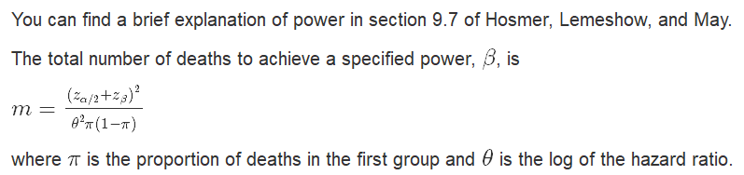
Selecting an appropriate sample size
Formula for power

Slide 4
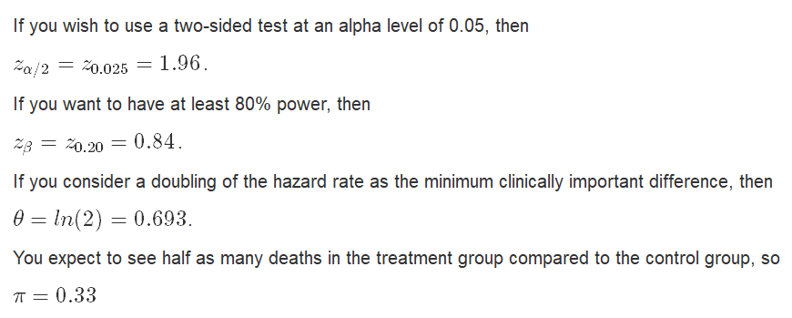
Selecting an appropriate sample size
Example of calculation

Slide 5
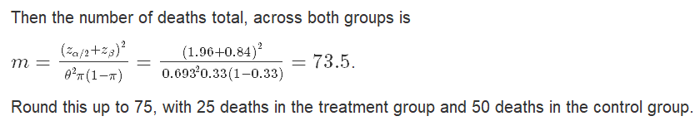
Selecting an appropriate sample size
Example of calculation

Slide 6
Selecting an appropriate sample size
Example of calculation

Slide 7
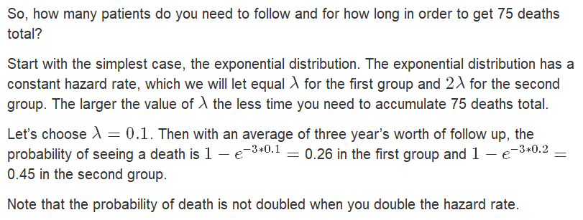
Selecting an appropriate sample size
You’re not done yet!

Slide 8
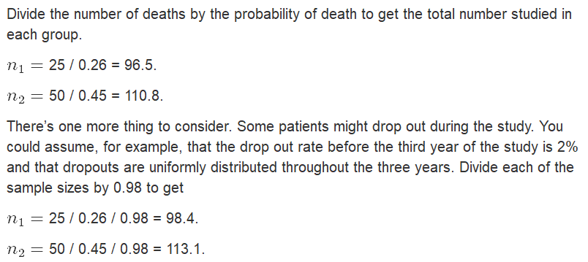
Selecting an appropriate sample size
You’re not done yet!

Slide 9
Selecting an appropriate sample size
Simulation of power
Many researchers consider a formula for sample size to be inadequate. The reasons include
The simplistic adjustments for censoring and dropouts.
The tendency for the sample size and power formulas to become unwieldy for even minor complications.
The inability to examine the sensitivity of your assumptions.
Simulation of power is fairly easy and very flexible.

Slide 10
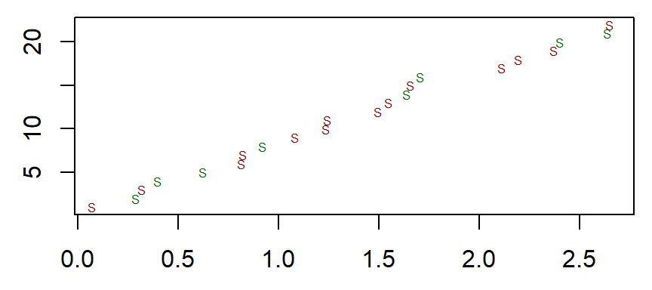
Selecting an appropriate sample size
Generate random starting times

Slide 11
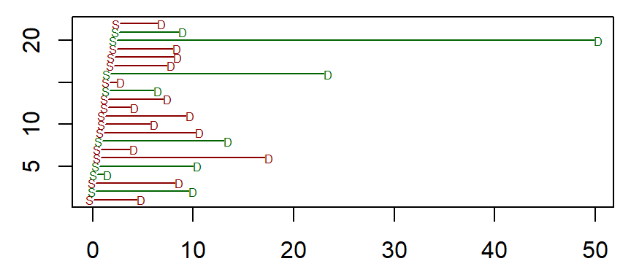
Selecting an appropriate sample size
Generate random deaths

Slide 12
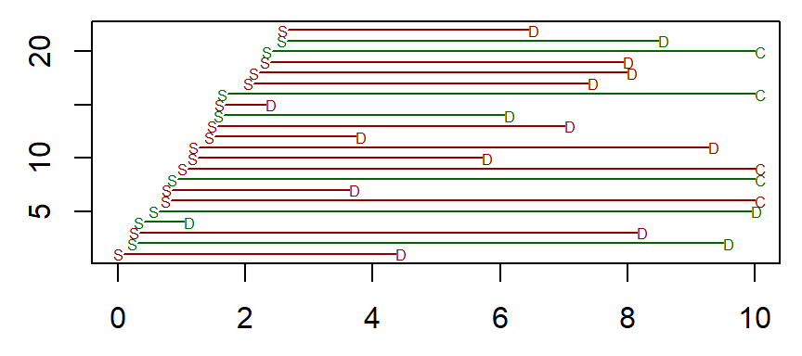
Selecting an appropriate sample size
Truncate the study at a maximum study duration time.

Slide 13
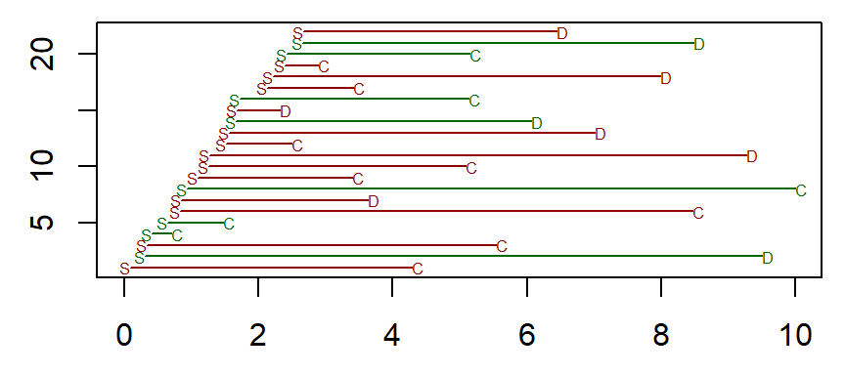
Selecting an appropriate sample size
Simulate a random process for early dropouts.

Slide 14
Selecting an appropriate sample size
Repeat 1,000 times.
Calculate the test statistic. Repeat 1,000 times. The proportion of test statistics that reject the null hypothesis is your power.
Consider sensitivity analyses. How much does your power/sample size change as you change some of the underlying assumptions.

Slide 15
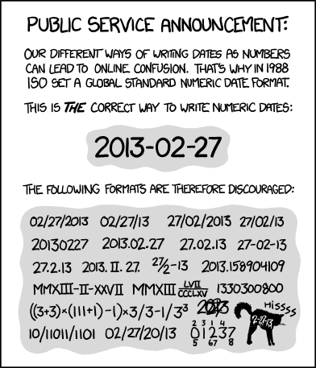

Slide 16
Data management
Internal storage of dates.
Every software program stores dates a little bit differently. R stores dates as internally as the number of days since January 1, 1970.
baseline <- as.Date("1/1/1970", format="%m/%d/%Y")
print(baseline)
## [1] "1970-01-01"
print(as.numeric(baseline))
## [1] 0

Slide 17
Data management
Internal storage of dates.
Every software program stores dates a little bit differently. R stores dates as internally as the number of days since January 1, 1970.
baseline <- as.Date("1/1/1970", format="%m/%d/%Y")
print(baseline)
## [1] "1970-01-01"
print(as.numeric(baseline))
## [1] 0

Slide 18
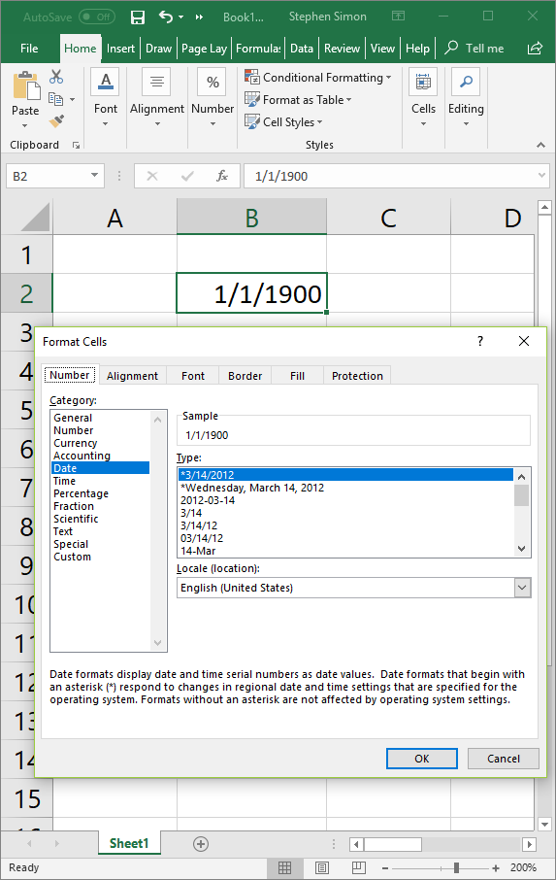
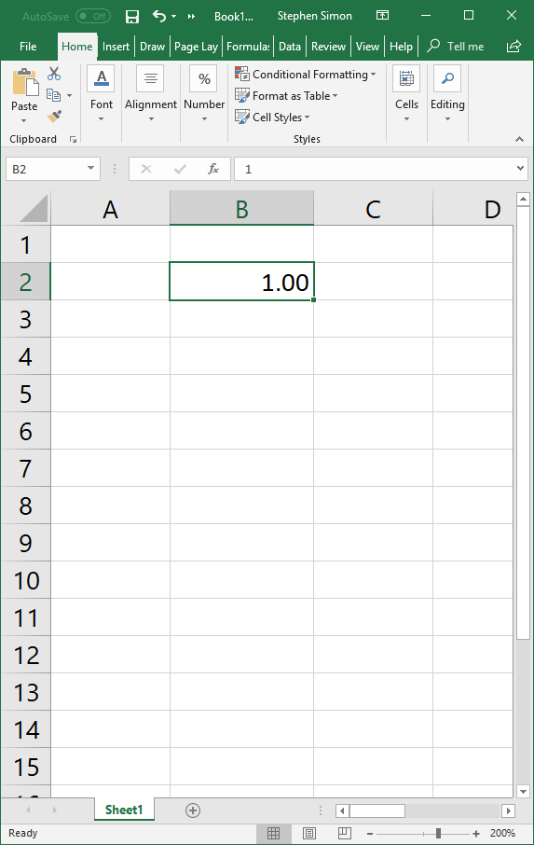

Slide 19
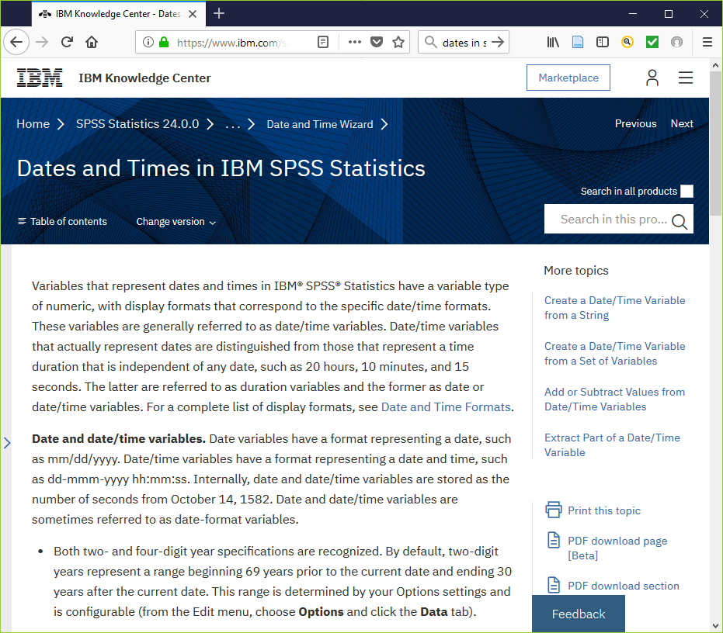

Slide 20
Conclusion
What have you learned today?
The hazard function is the short term death rate among those patients surviving to a specific time.
The log rank test is a simple test for comparing two or more Kaplan-Meier curves.
The Cox regression model allows for continuous predictors and risk adjustment.
The Cox model assumes proportional hazard functions and compares groups using a hazard ratio.

